Slide 1

Web Programming Basics

Slide 2
Content
HTML and HTML Forms
Server-Side Programming
Client-Side Programming
.NET Framework
Common Language Runtime (CLR)
Visual Studio 2017 Environment
Application: Currency Converter
Anadolu University

Slide 3
Web Pages
Static Web Pages: Content doesn’t change when requested by a user
Dynamic Web Pages: Content changes depending on the user’s request and preferences
  Client-Side: Executed in the browser
  Server-Side: Executed in the server
Anadolu University

Slide 4
HTML
Early websites were not web applications
They were like brochures
HTML only displays the information
HTML has two types of contents: Text and Tags
HTML actually doesn’t do anything
Saved in a fixed file (for example index.html)
No interactivity
Doesn’t require a web server
Anadolu University

Slide 5
HTML Example
<html>
<head>
<title>Sample Web Page</title>
</head>
<body>
<h1>Sample Web Page Heading</h1>
<p>This is a sample web page.</p>
</body>
</html>
Anadolu University

Slide 6
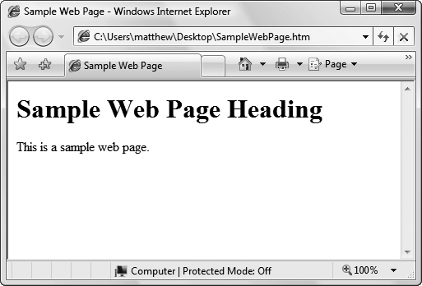
HTML Example
Anadolu University

Slide 7


An HTML Request
Internet
Request
HTML Document
Display HTML Document
Anadolu University

Slide 8
Browsers
Internet Explorer, Firefox, Opera, Google Chrome, Safari, Netscape, Camino, etc.
Browsers display HTML pages
Different browsers display the same page differently
Incorrect HTML may be displayed weirdly or not at all in some browsers
There are different versions of browsers for mobile devices too
Anadolu University

Slide 9
HTML Forms
Introduced by HTML 2.0
Graphical widgets or controls (text boxes, buttons, drop-down lists, etc.) are added
These controls should be put between <form> and </form> tags
Standard input pages can be designed
Input data are sent to web server
Web server processes the data
Anadolu University

Slide 10
HTML Forms Example
<html>
<head>
<title>Sample Web Page</title>
</head>
<body>
<form>
<input type="checkbox" /> This is choice #1<br />
<input type="checkbox" /> This is choice #2<br /><br />
<input type="submit" value="Submit" />
</form>
</body>
</html>
Anadolu University

Slide 11
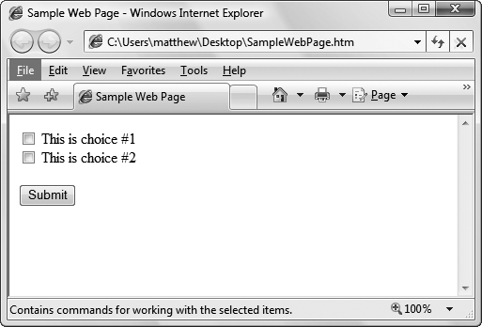
HTML Forms Example
Anadolu University

Slide 12
Methods of Sending Information
The Form object may be used to send the data to another page using “action” attribute:
<form action="Another_Page.php">
<input type="checkbox" /> This is choice #1<br />
<input type="checkbox" /> This is choice #2<br /><br />
<input type="submit" value="Submit" />
</form>
Form object can send values in two separate methods: POST and GET:
<form method="GET">...</form>
<form method="POST">...</form>
Anadolu University

Slide 13
Methods of Sending Information
POST
  Default method
  User data is combined in a special form and sent to the server
GET
  User data is added to the end of the URL address
  Data is sent as an encoded stream
  Example: http://ceng.anadolu.edu.tr/Homeworks.aspx?code=bim308&hwnum=2
What about refreshing pages using POST and GET?
Anadolu University

Slide 14
Client-Side Programming
Aims to enhance the appearance of web sites
JavaScript, ActiveX, Java, Flash, Silverlight, etc.
Doesn’t involve any server processing
The complete application is downloaded to the client browser and browser executes it locally
Provides immediate feedback to the user
Reduces the load on a server
Reduces network traffic
Client-side technologies are not supported equally by all browsers and operating systems
Anadolu University

Slide 15
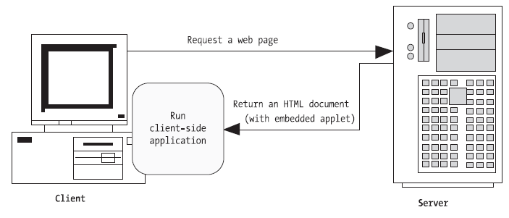
A Client-Side Web Application
Anadolu University

Slide 16
A Client-Side Web Application
Internet
Request
HTML Document
(with embedded applet)
Run Client-side application
Anadolu University

Slide 17
Server-Side Programming
Executed on the server side
Early web development technologies used CGI
Common Gateway Interface (CGI)
In CGI, web server launch a completely separate instance of the application for each web request
The same executable will work for IIS as it does
To counter these problems, high-level development platforms are created, such as PHP, JSP, ASP, and ASP.NET
Anadolu University

Slide 18
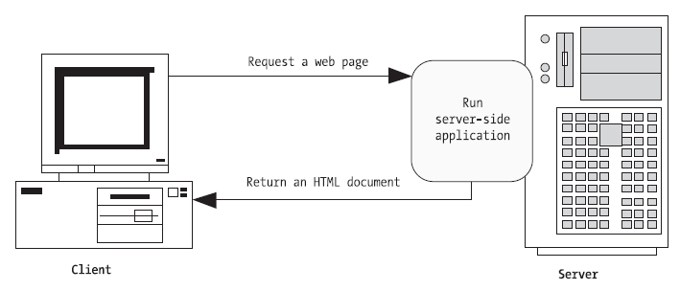
A Server-Side Web Application
Anadolu University

Slide 19
A Server-Side Web Application
Internet
Run Server-Side Application and Process Input Data
Request
HTML Document
Display Web Page
Anadolu University

Slide 20
High-Level Dev. Platforms
Allow developers to program dynamic web pages without worrying about the low-level implementation details
High-level development platforms are widely used in highly-traficked e-commerce sites and mission-critical business applications
Anadolu University

Slide 21
Classic ASP Example
<html>
<body>
<% response.write("Hello World!") %>
<% response.write("<p style='color:#0000ff'>Hello World!</p>") %>
</body>
</html>
Anadolu University

Slide 22
PHP Example
<html>
<body>
<?php echo "Hello World!"; ?>
<?php echo "<p style='color:#0000ff'>Hello World!</p>"; ?>
</body>
</html>
Anadolu University

Slide 23
Classic ASP vs. ASP.NET
ASP is a script-based programming language that requires a thorough understanding of HTML and a good deal of painful coding
ASP.NET is an object-oriented programming model that lets developers to develop websites as easily as Windows applications
Anadolu University

Slide 24
ASP.NET
A server-side technology
All ASP.NET codes are executed on the web server
When the code is finished executing, the user receives an ordinary HTML page, which can be viewed in any browser
Anadolu University

Slide 25
Advantages of Web Applications
Web applications don’t require setup CDs, downloads, and other tedious (and error-prone) deployment steps
A web application can be used on any computer that has Internet access
Users don’t have to download and install the latest version of the application
Design issues are more simple according to Windows applications
Designing multi-user applications are simple
Anadolu University

Slide 26
Disadvantages of Web Applications
When developers use client-side technologies, they encounter cross-browser compatibility problems
Developers should test their websites with different browsers and operating systems
Only Internet-based applications can be developed
Anadolu University

Slide 27
Why Use Server-Side Programming Instead of Client-Side?
Isolation: Client-side code can’t access server-side resources
Security: End users can view client-side code
Thin clients: Mobile phones, PDAs, etc. don’t support all features of a traditional browser
Note: PDA - personal digital assistant can function as a cellular phone, fax sender, Web browser and personal organizer.
Anadolu University

Slide 28
Best Solution?
Combining server-side and client-side programming is the best solution
ASP.NET controls can detect capabilities of the client browser
If browser supports JavaScript, these controls return a web page that incorporates JavaScript
Ajax technology can be used with ASP.NET effectively
However, ASP.NET codes are always executed on the server
Anadolu University

Slide 29
The .NET Framework
.NET Framework is a cluster of several technologies:
  .NET Languages: C#, Visual Basic.NET, JScript.NET, J#, C++
  The Common Language Runtime (CLR): The engine that executes all .NET programs
  The .NET Framework Class Library: The class library for many prebuilt functionality (e.g. ADO.NET, Windows Forms, etc.)
  ASP.NET
  Visual Studio.NET
Anadolu University

Slide 30
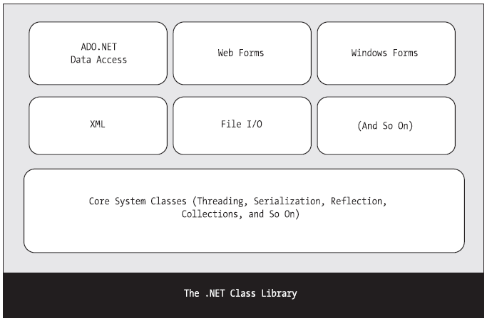
.NET Class Library
Anadolu University

Slide 31
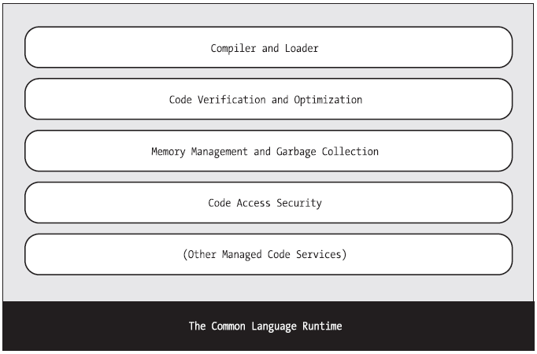
Common Language Runtime (CLR)
Anadolu University

Slide 32
ASP.NET Versions
ASP.NET 1.0: First release
ASP.NET 1.1: Added performance, bug-fixes but no new features
ASP.NET 2.0: Prebuilt goodies that developers can use without writing much code. New features: Website navigation, easier database access, theming for web page design
ASP.NET 3.5: Embedded Ajax, LINQ
Anadolu University

Slide 33
ASP.NET Versions
ASP.NET 4.5:
1. Cross-platform & container support
2. High performance
3. Asynchronous via async/await
4. Unified MVC & Web API frameworks
….
Anadolu University

Slide 34
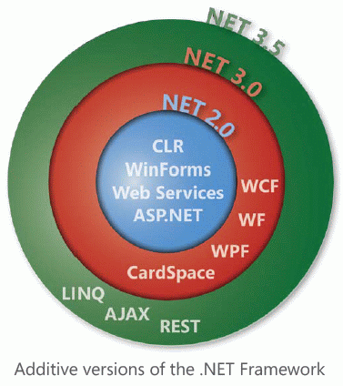
.NET Framework Versions
Anadolu University

Slide 35
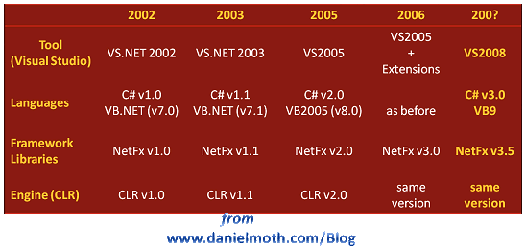
History of .NET
Anadolu University

Slide 36
.NET Languages
C# is designed for .NET technology
C# and VB.NET uses the same .NET library
C# and VB.NET codes are very similar
VB6.0 and VB.NET are different languages because VB.NET is an object-oriented language
A C# programmer can easily understand and convert VB.NET programs
Anadolu University

Slide 37
Intermediate Language (IL)
All .NET languages are compiled into another low-level language before the code is executed
This lower-level language is the Common Intermediate Language (CIL, or just IL)
Because of this feature, C# programs can use VB.NET (or any other .NET language) components
Every EXE or DLL file built with a .NET language contains IL code
.NET Framework should be installed on the computer that the .NET program is deployed
Anadolu University

Slide 38
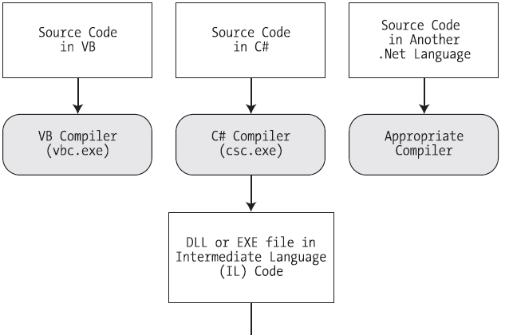
Compilation
Anadolu University

Slide 39
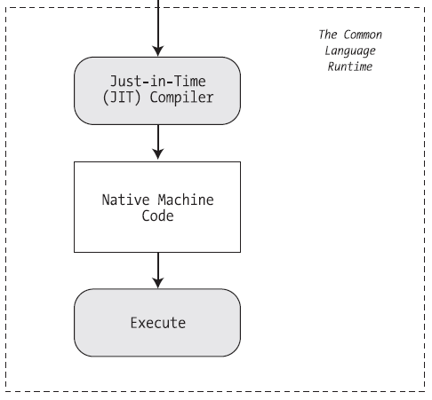
Execution
Anadolu University

Slide 40
Visual Studio Features
Page Design: Drag & drop style; you don’t need to understand HTML
Automatic Error Detection
Debugging Tools
Intellisense: Statement completion for recognized objects and listing information automatically
Anadolu University

Slide 41
.:. .:. Application .:. .:.
Creating a web project
File system or local IIS?
What is web solution and web project?
Where is the solution (.sln) file?
Solution Explorer
Adding Web Forms
Design View, Source View, Split View
Adding Web Controls in Design and Source views
Grid Layout vs. Flow Layout
Anadolu University

Slide 42
.:. .:. Application .:. .:.
Properties Window
Page Directive
Attributes
Adding Event Handlers (by hand, by designer, by Properties Window)
Outlining
  Collapsing methods, regions
Anadolu University

Slide 43
.:. .:. Application .:. .:.
Intellisense
  Member list
  Overloaded method and parameter information
  Error Underlining
Importing namespaces
Debugging
  Breakpoints, F9, F5, F10, F11, Ctrl-F5, Shift-F5, Shift-F11, Run to Cursor
  Conditional Breakpoints, Variable Watches
Currency Converter Example
Anadolu University

Slide 44
References
Beginning ASP.NET 3.5 in C# 2008: From Novice to Professional
http://aspnet.4guysfromrolla.com/articles/112107-1.aspx
http://cs.haifa.ac.il/courses/webp/
Anadolu University

